Slide 1


by Jamie Morden
Ubiquitous Computing 2

Slide 2
Context of use
Spotify’s own playlists consists of the same songs and artists from your listening history, making it hard to discover new music
Making playlists is a long and tedious task.
Simplify playlist creation while enhancing user engagement through an interactive game
Target audience – music enthusiasts who use Spotify and are interested in personalised playlist creation with a gamified experience
Notes:
The purpose of the application is to provide an engaging, gamified solution to creating playlists on Spotify, I felt this was an issue to be addressed for several reasons.
Spotify’s playlist recommendations usually consist of the same songs and artists from the user's listening history, across multiple playlists making it harder to discover new music.
Another reason for this app is creating playlists manually is repetitive and rather tedious, especially if you are trying to find new music to listen to.
This app is designed for music enthusiasts who use Spotify as their main music streaming service, the app allows the user to create personalised playlist with a gamified experience.

Slide 3
Project Overview

Slide 4
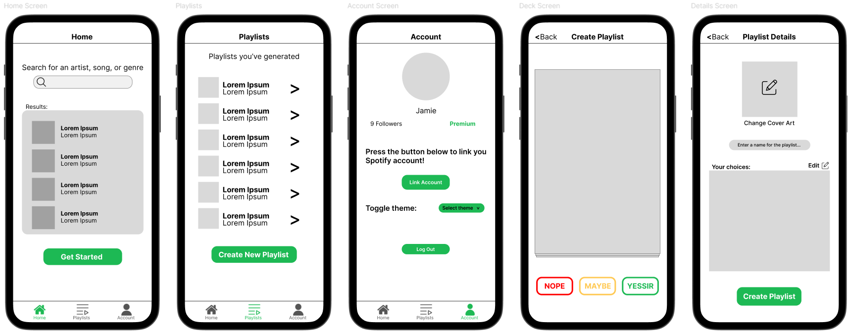
Design justification
Notes:
I wanted to use a simple design throughout, after playing with a few designs within figma, I came up with these screens.
The homeScreen is simple with a single search bar, a list of search results and a button, I felt this was the only necessary components needed for the home screen as it reduces clutter and cognitive load /////(Add reference about cognitive load)//////.
The playlists screen was again designed to be simple, a list of playlists with a button at the bottom.
The account screen is a little more cluttered, displaying the user profile at the top, I felt this was necessary for the user experience, displaying this information shows a link between the app and Spotify.
The gamescreen utilises the main deck component with 3 buttons at the bottom for handling swipe operations.
The playlist details screen has an image picker component, with a playlist name text input and a list displaying the tracks in the playlist.

Slide 5
Features implemented – Search

Slide 6
Features implemented – Main Game

Slide 7
Features implemented – Create playlist

Slide 8
Features implemented – Stored playlists

Slide 9
Features implemented – Login/out

Slide 10
Features implemented – Theme toggle

Slide 11
Features implemented – Screen reader accessibility

Slide 12
Refrences

